Slide 1

CRYLYA WHEELCHAIR
Give your loved ones wings to fly
By Team Sinister Rewind

Slide 2
OUR TEAM
Adamay Mann
Shreya Chopra
Kunal Demla

Slide 3
TABLE OF CONTENTS
01
The Problem
03
Our Solution
02
Market and competition
04
Future Prospects

Slide 4
01
The Problem

Slide 5
INTRODUCTION
People with disabilities face several physical barriers outside the boundaries of their home.
All these factors prevent them from benefiting from any system or entity, maximizing their full potential and enjoying their developmental rights.

Slide 6
THE PROBLEM
Some commonly seen issues are:
Steps and curbs that block a person with mobility impairment from entering a building or using a sidewalk.
Absence of a weight scale that accommodates wheelchairs or others who have difficulty stepping up.
Lack of access to accessible or convenient transportation for people who are not able to drive because of vision or cognitive impairments.
Public transportation that may be unavailable or at inconvenient distances or locations.

Slide 7
02
Our Solution

Slide 8
SOLUTION
Crylya wheelchair has been thoughtfully designed to help specially-abled people overcome their disabilities and dependence on others. With its special features, it will help them get around all physical and other barriers, that prevent persons with disabilities from equally accessing opportunities and participating fully in all aspects of life. It aids with basic provisions so they don’t have to rely on anyone else and go through the emotional turmoil of feeling like a burden to others..

Slide 9
Key Features
Various Features Offered by Crylya Features

Slide 10
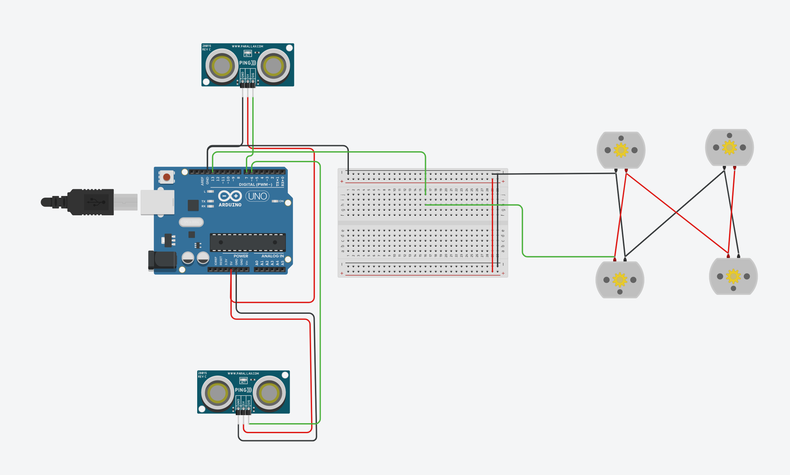
AUTOPILOT
Automatic navigation around obstacles.
The sensors detect if there is an object in front of the chair and stop or turn accordingly.
TinkerCAD Simulation link:
Autodrive | Tinkercad

Slide 11
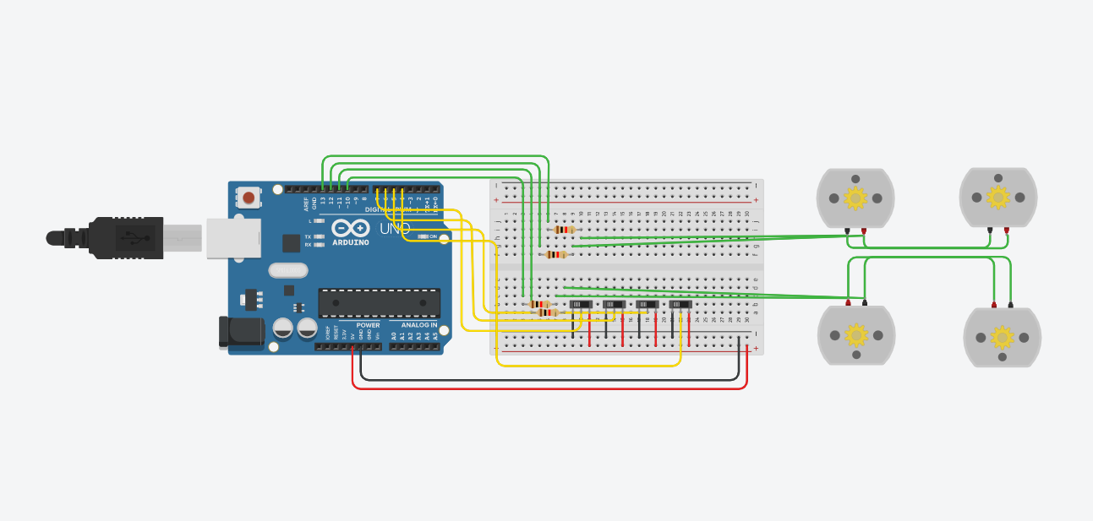
MANUAL NAVIGATION
The wheelchair can be navigated manually using joysticks provided on the arm of the wheelchair.
There are 2 joysticks provided on the arm of the chair, one to move forward and backwards and the second for left and right navigation.
TinkerCAD Simulation link:
manual driving | Tinkercad

Slide 12
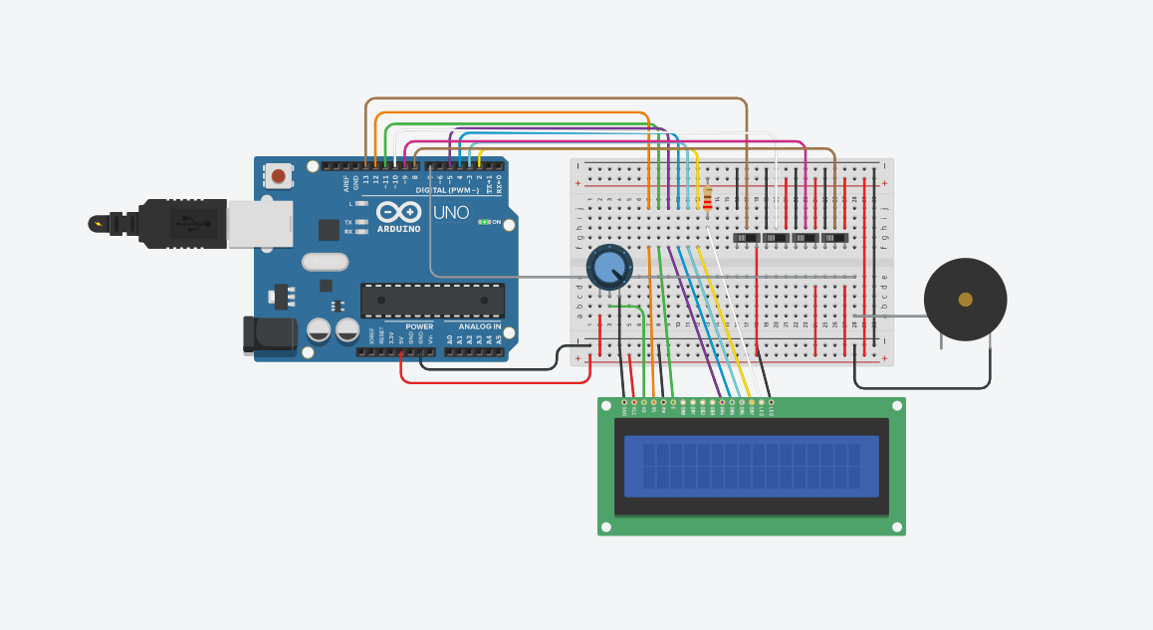
BUTTONS
Located on the arm of the wheelchair are 4 buttons for Food, Water, Toilet & Pain/Emergency
When any of these buttons is pressed, the LCD Display in front of these buttons will display what the person needs and a notification will be sent on the app.
In case the pain/emergency button is pressed, it will set off an alarm on the chair and will alert an emergency contact via the app.
TinkerCAD Simulation link:
LCD Display | Tinkercad

Slide 13
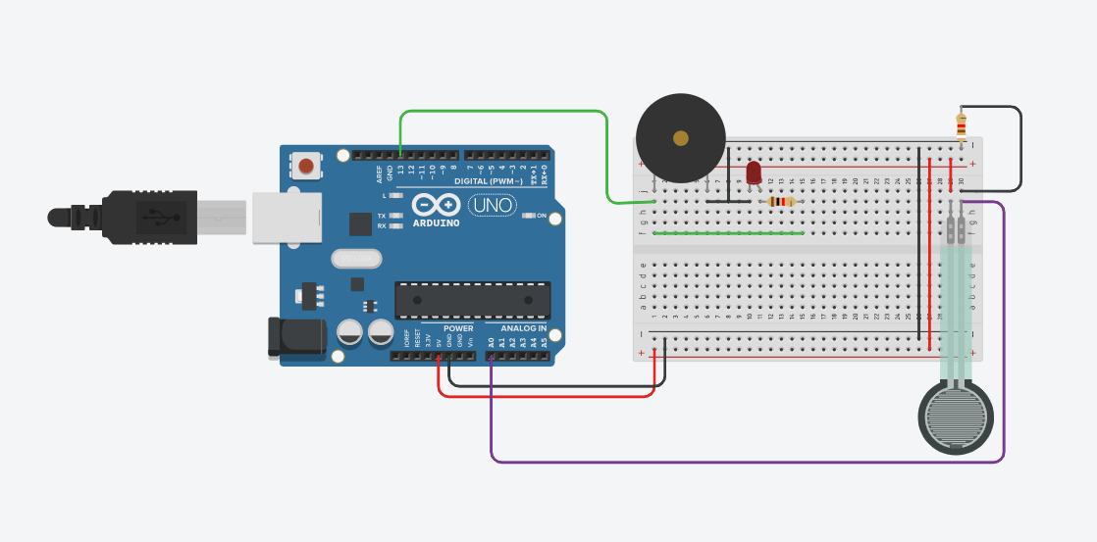
FALL ALERT
If the wheelchair is switched on and the sensor detects that no one is sitting on the chair then a notification will be sent on the app and a message will be sent tothe listed emergency contacts.
TinkerCAD Simulation link:
Fall sensor | Tinkercad

Slide 14
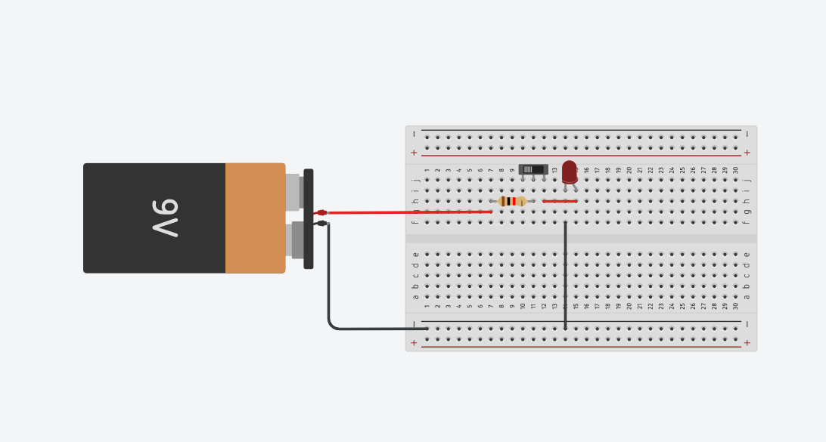
HEADLIGHTS
Headlights are located on the front of the wheel chair for navigation in the dark.
They can be switched on by pressing a button located on the arm of the chair.
TinkerCAD Simulation link:
Flashlight | Tinkercad

Slide 15


HEART RATE AND BLOOD PRESSURE MONITORING
A sensor is located on the arm of the chair that measures heart rate and blood pressure levels.
The user needs to press their finger against the sensor which will then measure their heart rate and blood pressure.
The readings will be updated on the app.

Slide 16
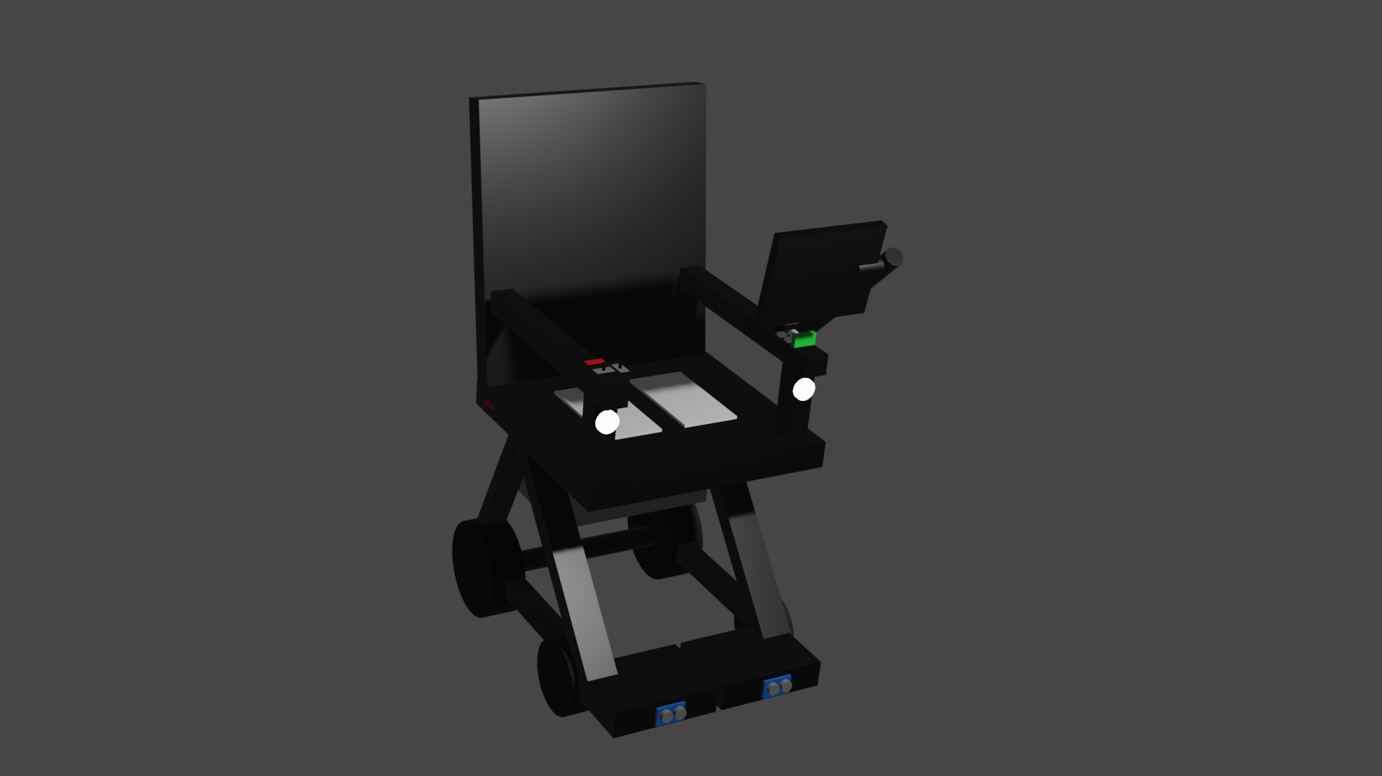
3D MODEL
Take a look at this video to see the 3D Model of the wheel chair
(Note: not to scale)

Slide 17

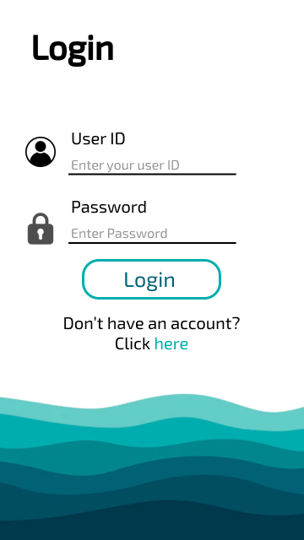
APP UI

Slide 18
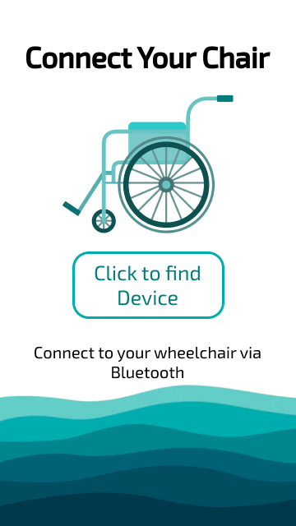
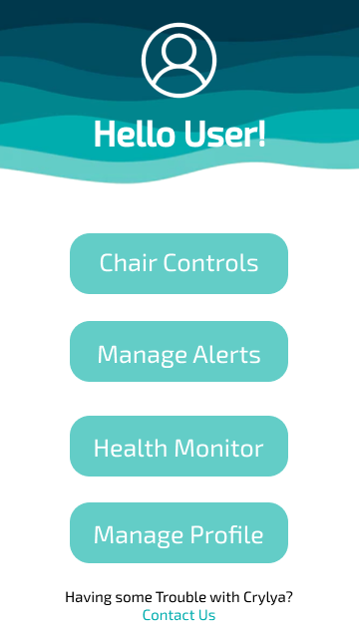
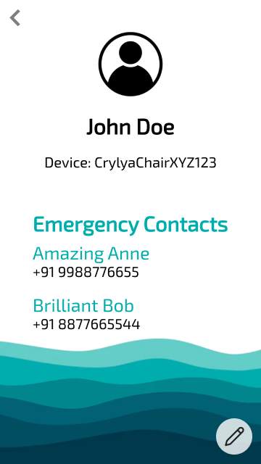
APP UI

Slide 19


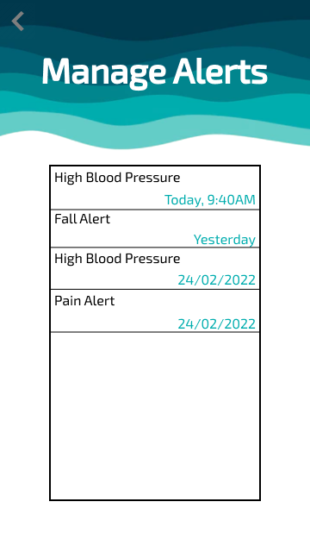
APP UI

Slide 20
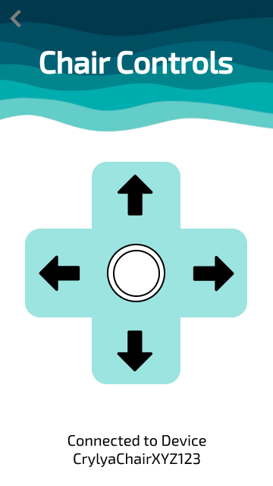
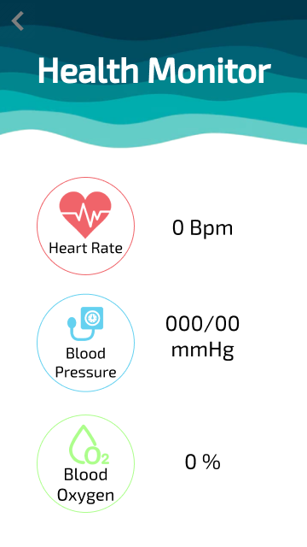
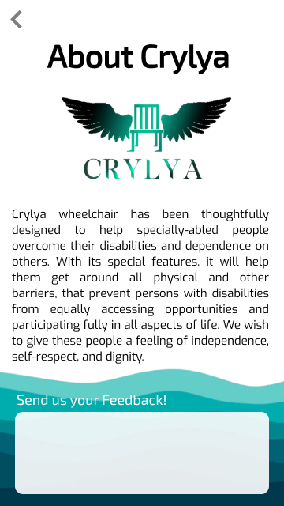
APP UI

Slide 21
TECH STACKS USED
3D Modelling
Arduino Programming
Figma
Photoshop
A 3D Model of the Wheelchair is created on Blender
We used Arduino Programming on TinkerCAD to simulate the features
We have used Figma to design our App UI/UX
Our logo wa designed on Adobe Photoshop

Slide 22
03
Marketing and Competition

Slide 23
UNIQUE SELLING POINTS
01
02
03
Fall Alert
App Connectivity
Health Monitors
There are no commercially available wheelchair companies that have a fall detection feature
Receiving alerts and updates on the app is a feature that you’ll only find in Crylya
We are the only ones that have added this feature to our wheelchair

Slide 24
04
Future Prospects

Slide 25
FUTURE PROSPECTS
Portability
Voice Recognition
Speed Controls
A foldable wheelchair that can be carried around easily when not in use
Using speech inputs for navigation and various other functions
Adding a feature to control the speed of the chair
Slopes and Stairs
Adding other Attachments
Modifying the chair to navigate other terrains such as stairs and slopes
Controlling the chair via the app

Slide 26
The only disability in life is a bad attitude
-Scott Hamilton

Slide 27
THANK YOU

